Slide 1
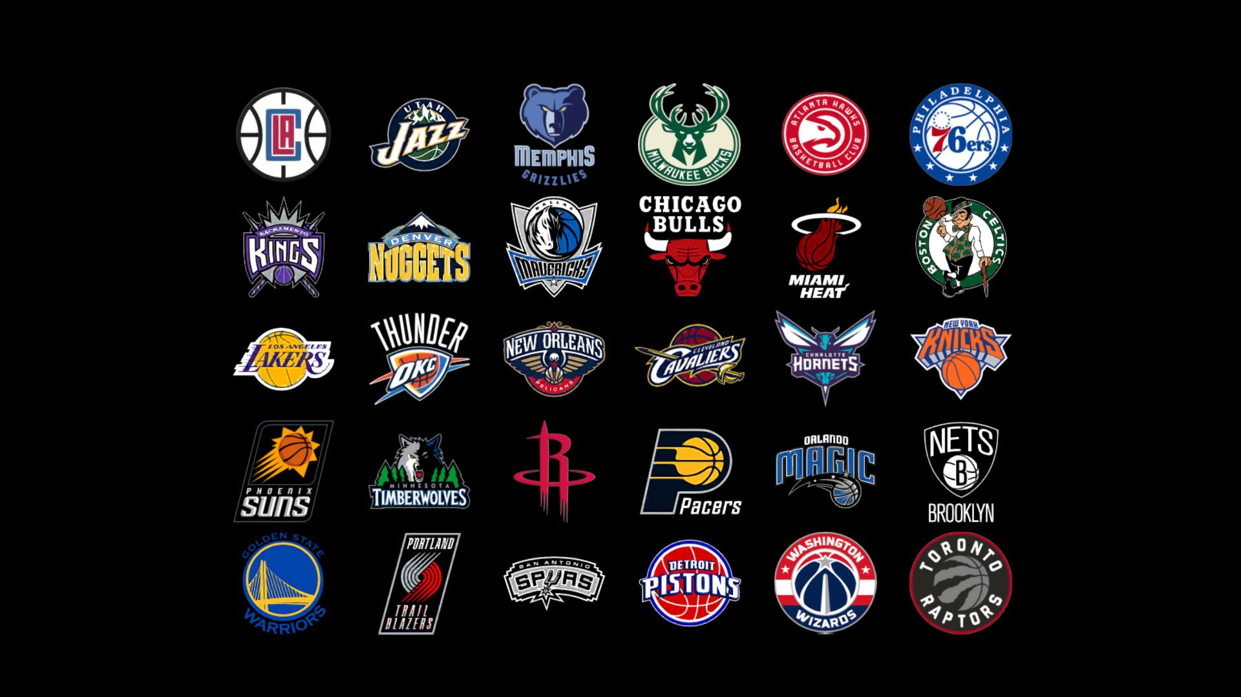


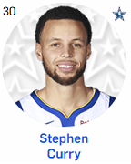
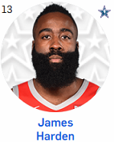
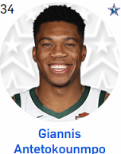
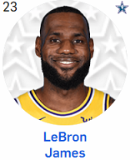

NBA DFS Lineup Optimizer
Feb. 28, 2020
Presented By:
Jeremy DeWalt

Slide 2

Agenda
Background
Problem Statement
Problem Solution
Requirements
Design Diagrams
Development
Lessons Learned
References

Slide 3
Background
Daily fantasy sports (DFS) is a multi-million dollar industry; generating $335 million in revenue from $3.2 billion in entry fees during the 2017-2018 fiscal year (fiscal year ended in March). DFS consist of contests involving football, basketball, baseball, hockey, and other sports; college and professional.
DraftKings and FanDuel are DFS industry leaders. Top Score optimizer software is web-based and tailored for NBA fantasy players using the Draftkings fantasy basketball scoring model.

Slide 4
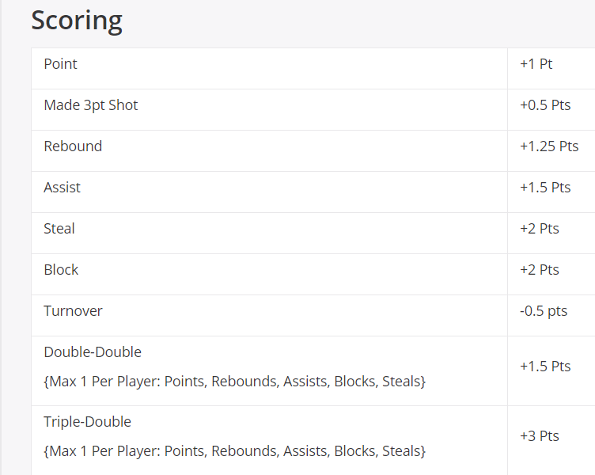
Background
DraftKings Fantasy Point Scoring Model

Slide 5
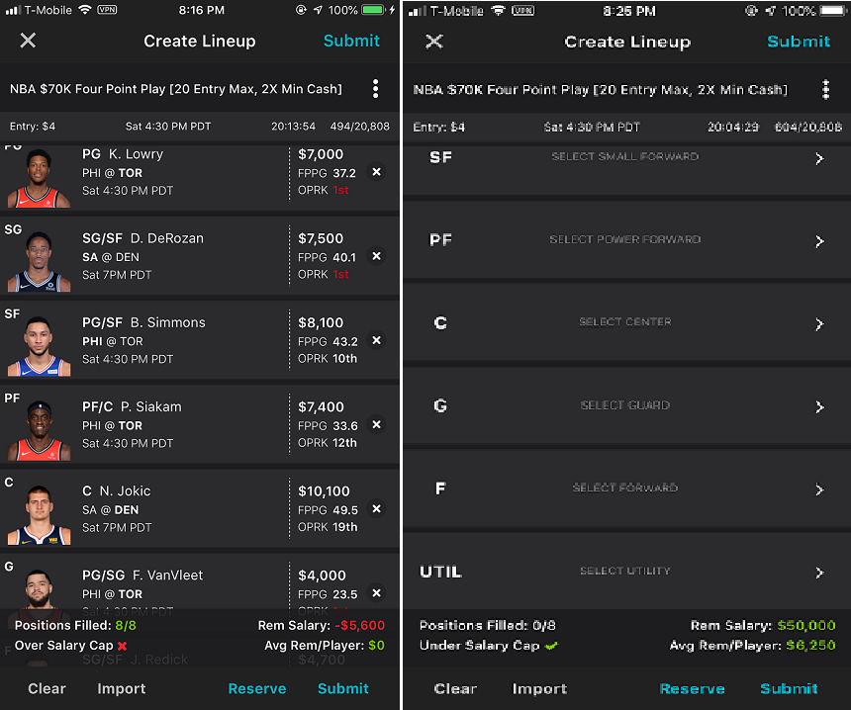
Background
DFS classic fantasy basketball lineup consists of the following 8 player positions: Point Guard (PG), Shooting Guard (SG), Small Forward (SF), Power Forward (PF), Center (C), Guard (G), Forward (F), Utility (UTIL).
Many players have multiple designations that allow them to fill multiple positions. For instance, a player tagged as a PF/C can fill the PF, F, C, and UTIL position. Any player can fill the UTIL position.
Players have designated salaries based on their performance. A valid lineup meets a $50,000 salary cap for all the 8 players selected.
Goal is to score as many fantasy points as possible with a selected lineup
Mobile App view of DraftKings DFS basketball

Slide 6
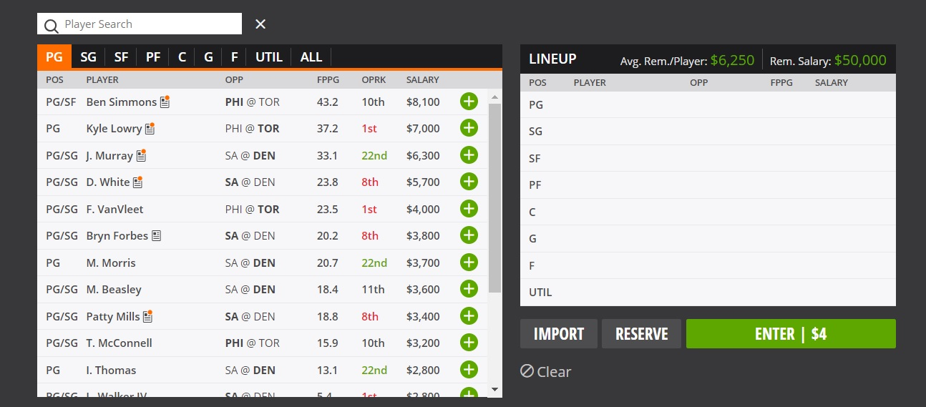
Background
Web App view of DraftKings DFS basketball

Slide 7
Problem Statement
The DFS NBA basketball lineup optimizers provided by Rotowire, FantasyPros, and others base a players value on statistics compiled throughout the year and do not provide a ranking system that caters solely to the contest a user plans to enter. Furthermore, no data addressing the standard deviation of a player’s recent performance is provided.

Slide 8
Problem Statement
Rotowire NBA basketball optimizer (DraftKings scoring model)

Slide 9
Problem Statement
FantasyPros NBA basketball optimizer (DraftKings scoring model)

Slide 10
Problem Solution
Top Score optimizer application will use only recent player statistics (last 5 games) when evaluating a player.
All players on teams participating in contests on a given day will be ranked against one another; based on their cost per point. Those players with less than 5 games will be assigned an N/A ranking.
A player’s fantasy point per game (fppg) standard deviation will be provided to fantasy players while constructing their lineups.

Slide 11
Functional Requirements
PG, SG, SF, PF, C, G, F, and UTIL positions must be filled to submit a valid lineup.
Salary cap mandates lineup must be at $50,000 or less for valid submission.
All players in a lineup can not be playing in the same game.
All players with 5 games played receive a ranking against all other players in a contest; otherwise an N/A ranking is applied.
Each player with games played will have their standard deviation made available to application users; otherwise N/A will be noted

Slide 12
Functional Requirements
A contest requires at least 2 games to be played in it
A lineup can not be edited after a contest starts
Application users must be 18 years or older
All players will be assigned a salary the user must pay in order to draft them
All players can fill the UTIL position if they have not been drafted
A player can only be drafted once in a lineup
Players can be drafted into multiple positions depending on their position designation (i.e. player with PG/SF designation can be drafted as a PG, G, SF, F, or UTIL).

Slide 13
Functional Requirements
Player is assigned to 1 of 31 Teams. Team NON is for players cut from a team and not picked up by another yet.
An account must be created to use the application
Player salary and fantasy point data will be acquired from DraftKings.
User must have be able to create a lineup, edit a lineup (for contests not started), view and delete any saved lineups they have.
Database is required to manage data exchange from user actions requiring lineup creation, edits, viewing and deletions.

Slide 14
Functional Requirements
User can logout of their account
Team plays in only 1 game per day
Players will have a status (OK, OUT, Q) to let users know what condition they are in prior to drafting them
A players last game will be made available so the user knows if they are coming back from a delayed lay-off from play

Slide 15
Non-Functional Requirements
Aesthetically/visually pleasing User interface (GUI)
Application runs at an acceptable speed; no significant time delays
Errors are minimal

Slide 16
Assumptions
User already has knowledge of the DraftKings format and is looking to enhance their chances of producing a winning lineup using this optimizer.
User has basic reason and deduction skills to understand how the data being provided in Optimizer is relevant to them successfully producing the best lineup possible.

Slide 17
Use Case diagram

Slide 20
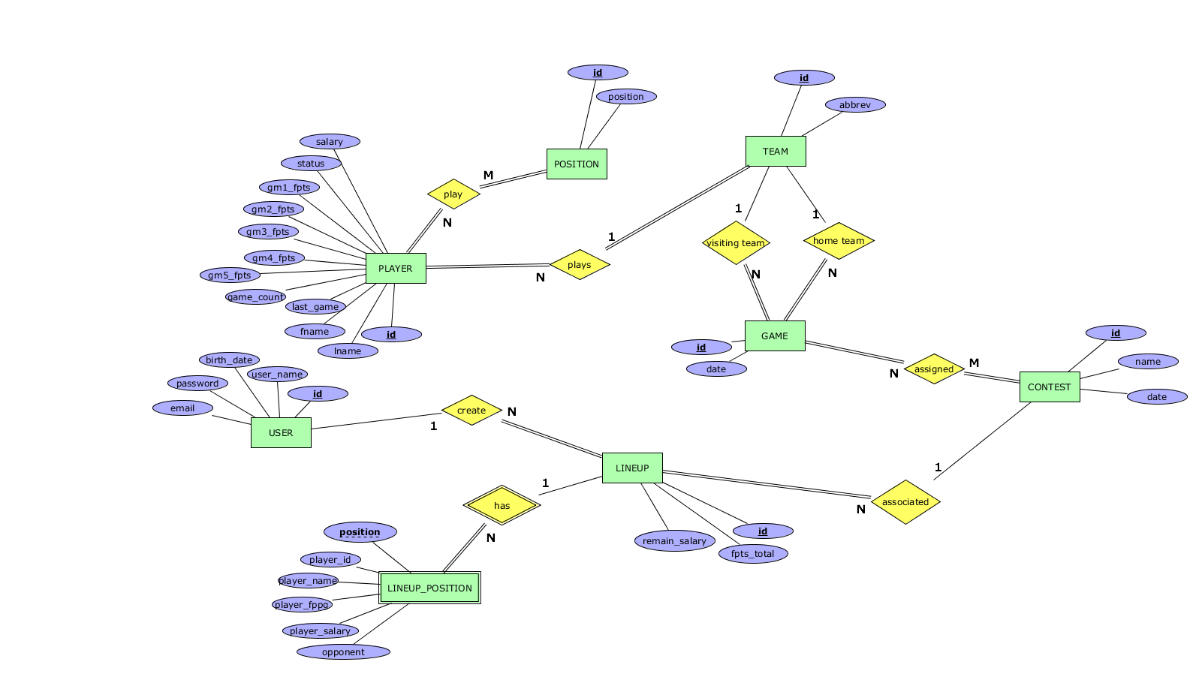
ER Diagram

Slide 21
Relational Schema

Slide 22
Standard Deviation

Slide 23
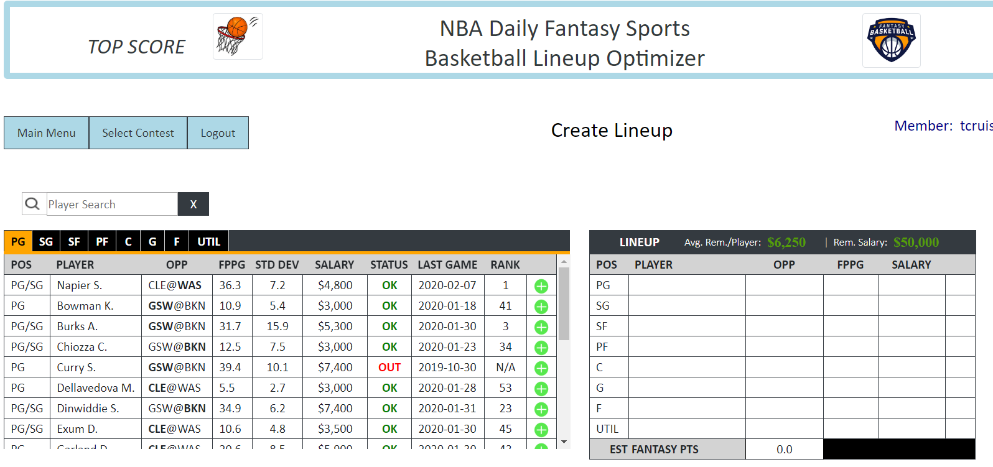
Development
Backend – PHP, (Node JS option)
Frontend – Javascript, Bootstrap 4, CSS, HTML, JQuery

Slide 24
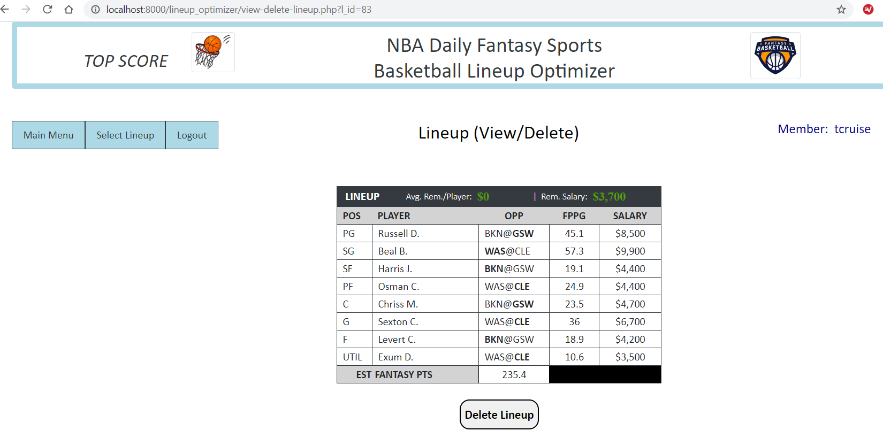
Development

Slide 25
Development

Slide 26
Lessons Learned
PHP headers are tricky. I was unable to implement a feature redirecting the user to 2 separate pages given the number of lineups they still had available due to “whitespace”.
json_encode allows retrieval of php variables in javascript
hidden inputs are very useful
node js was an alternative to connect to a mysql DB if I need to
JS functions every(), slice(), replace(), and submit(); along with the math js library
php’s math library was also useful

Slide 27
References
DraftKings. (2019). Draftkings daily fantasy: Rules & scoring. Retrieved from
https://www.draftkings.com/help/rules/nba
Gouker, D. (2018, June 27). New official data: Daily fantasy sports generated $335 million in revenue in a year.
Retrieved from https://www.legalsportsreport.com/21627/ny-dfs/
Maxim, B.R., & Pressman, R.S. (2015). Software engineering: A practitioner’s approach. New York, NY: McGraw-Hill Education.

